Slide 1

Pump Master
Birla Vishvakarma Mahavidyalaya
Computer Engineering Department
Course Code :- 4CP33
Project-Type :- FSEP
Company Name :- Emgage HR Simplified
Location :- Makarba, Ahmedabad
Faculty Supervisor :-
Prof. Narendra M. Patel
Prof. Prashant B. Swadas
Industry Guide :-
Mr. Jubin Patel (Director)

Slide 2
Table Of Contents
Project Description
Tech Stack
Modules
Architecture
Appreciations

Slide 3
Project Description

Slide 4
Tech Stack
Frontend :- HTML,CSS, Bootstrap, React.Js
Language :- Java
ORM Framework :- Hibernate
Web Framework :- Spring Boot
Database :- PostgreSQL
Version Control :- Git

Slide 5
Module
Add Petrol Pump Details
Add Petrol New Stock
Add Worker Details
Rate Change of petrol
Device raw Data
Device Firmware

Slide 6
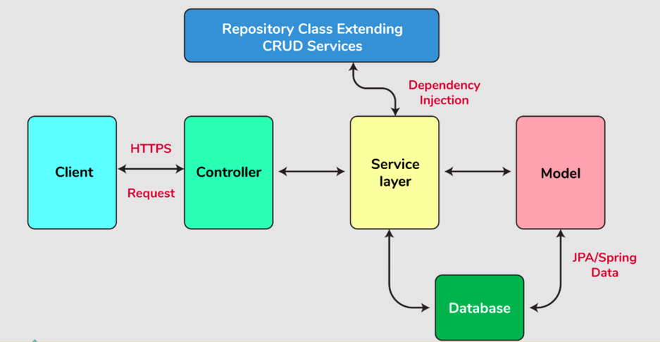
Service Architecture

Slide 7
Implementation

Slide 8
References
Spring Documentation
React.js
Redux Library
Hibernate
PostgreSQL

Slide 9
Thank You
That’s a Wrap!

